Slide 1
Final Project Retail Analysis with Walmart Data Student's Name: Hasan Abdulhadi

Slide 2
Introduction

Slide 3
STEP 1
Data Processing

Slide 4
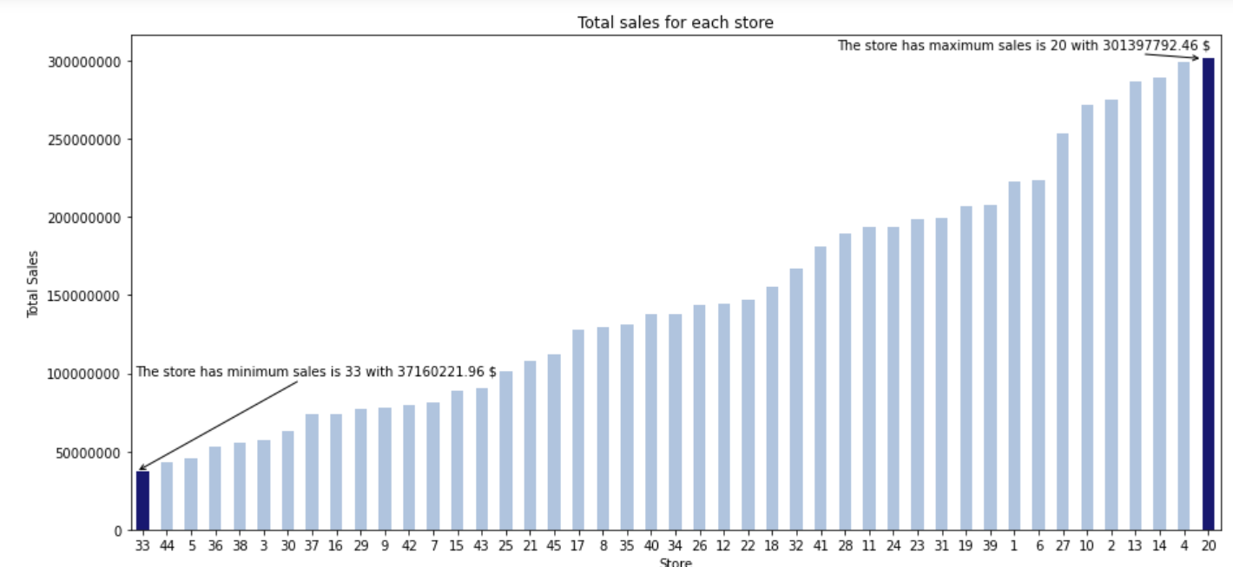

Slide 5
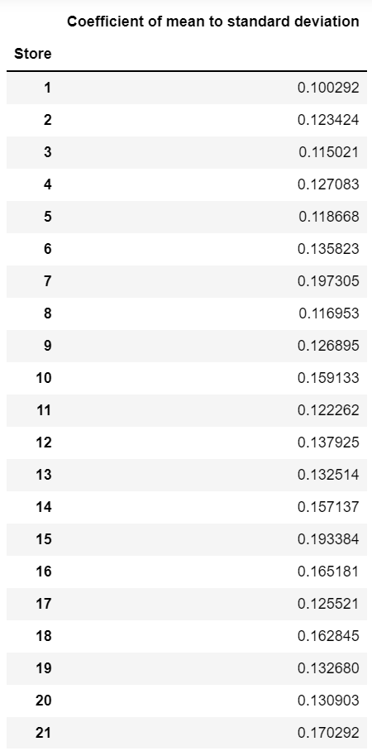

Slide 6
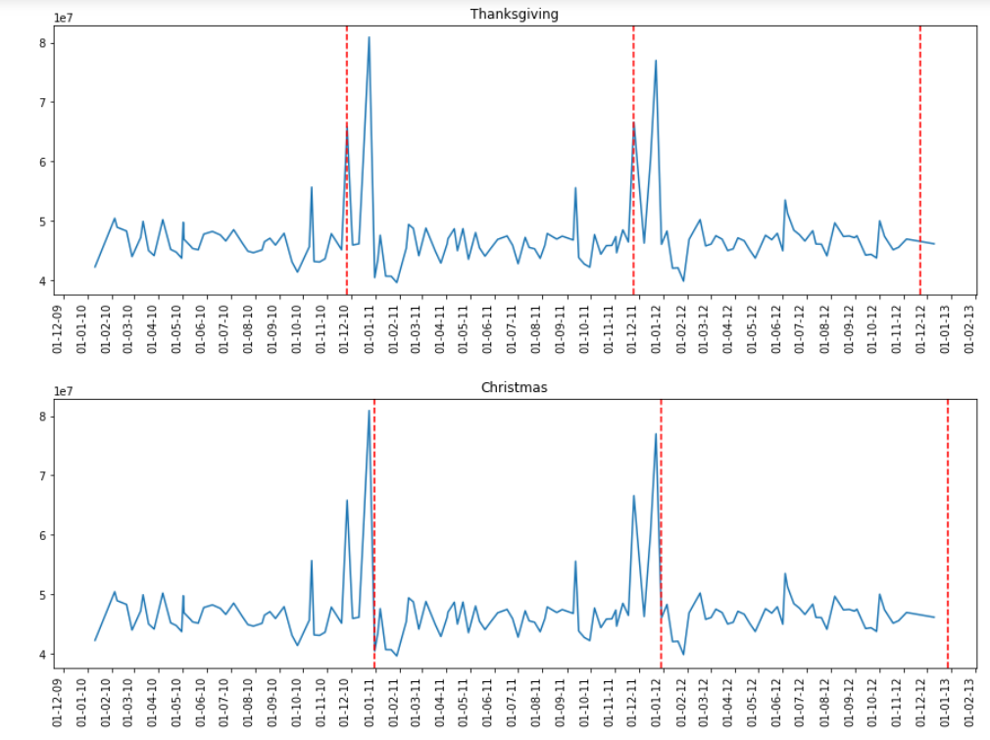

Slide 7
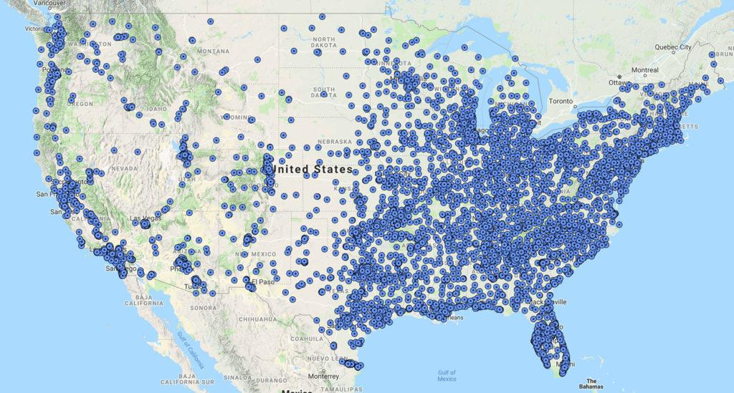

Slide 8
Conclusion

Slide 9
STEP 2
1-Which store has minimum and maximum sales?
2-Which store has maximum standard deviation, The sales vary a lot. Also, find out the coefficient of mean to standard deviation?
3-Which store/s has good quarterly growth rate in Q3’2012?

Slide 10
STEP 3
4-Some holidays have a negative impact on sales. Find out holidays which have higher sales than the mean sales in non-holiday season for all stores together
5-Provide a monthly and semester view of sales in units and give insights
6-Build prediction models to forecast demand

